Slide 1

AI-Based Natural Disaster Intensity Analysis
Team members:
Sujana Sri Chidara
Juveria Shaista
Mohhamed Gulam Mustafa
This Photo by Unknown author is licensed under CC BY.

Slide 2
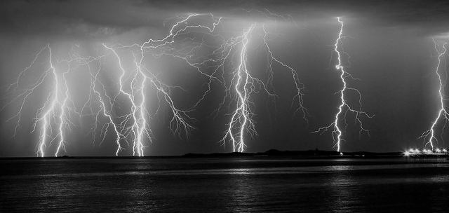
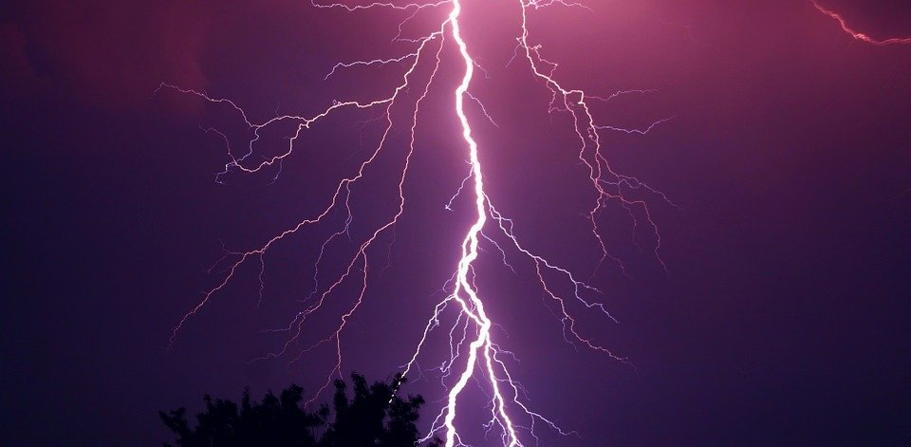
INTRODUCTION
Natural disasters not only disturb the human ecological system but also destroy the properties and critical infrastructures of human societies and even lead to permanent change in the ecosystem. Disaster can be caused by naturally occurring events such as earthquakes, cyclones, floods, and wildfires. Many deep learning techniques have been applied by various researchers to detect and classify natural disasters to overcome losses in ecosystems, but detection of natural disasters still faces issues due to the complex and imbalanced structures of images. To tackle this problem, we developed a multilayered deep convolutional neural network model that classifies the natural disaster and tells the intensity of disaster of natural The model uses an integrated webcam to capture the video frame and the video frame is compared with the Pre-trained model and the type of disaster is identified and showcased on the OpenCV .

Slide 3
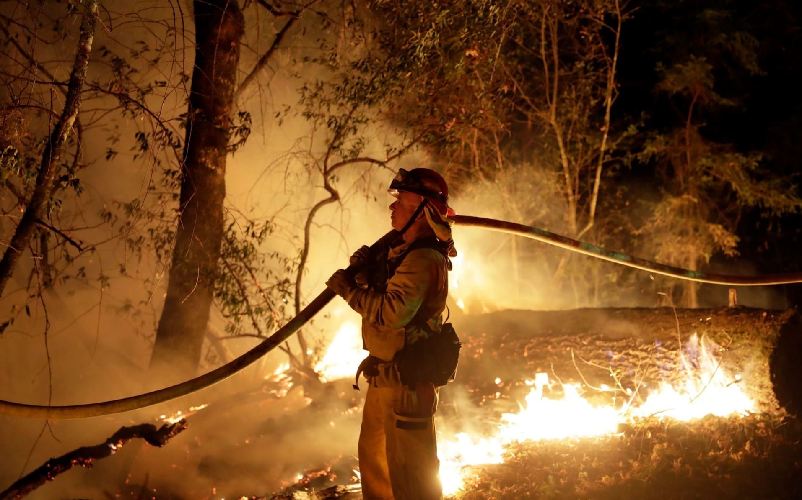
Problem Statement
Earlier we mainly focus on post disaster relief and
rehabilitation measures. Now the focus is shifted. As per
sec.2(e) of DM Act-2005,
Disaster Management means a coordination and integrated
process of planning, organizing, coordinating and
implementing measures which are necessary or expedient
for-
(i) Prevention of danger or threat of any disaster
(iv) Preparedness to deal with any disaster
(v) Prompt response to any threatening disaster situation or
disaster
(vi) Assessing the severity or magnitude of effects of any disaster
(vii) Evacuation, rescue and relief
(viii) Rehabilitation and reconstruction
This Photo by Unknown author is licensed under CC BY.

Slide 4
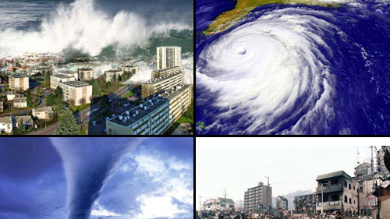
Solutions
Prevention:
Action within this segment is designed to impede the
occurrence of a disaster event and/or prevent such an occurrence
having harmful effects on communities or key installations.
Mitigation:
Action within this segment usually takes the form of
action within this segment usually takes the form of
specific programs intended to reduce the effects of disaster on a
nation or community. For instance, some countries regard the
development and application of building codes (which can reduce
damage and loss in the event of earthquakes and cyclones) as being
in the category of mitigation.
Preparedness:
Preparedness is usually regarded as comprising measures which
enable governments, organizations, communities and individuals
to respond rapidly and effectively to disaster situations.
This Photo by Unknown author is licensed under CC BY-SA.

Slide 5

Literature survey
1)Published in: 2015 International Conference on Circuits, Power and Computing Technologies [ICCPCT-2015] Date of Conference: 19-20 March 2015 Date Added to IEEE Xplore: 16 July 2015
Data mining offers great potential benefits for GIS ( Geographic Information System) based decision making. Spatial databases mainly store two types of data: raster data (satellite/aerial digital images) and vector data (points, lines, polygons). Need of Spatial database. To store and query data that represents objects defined in a geometric space. To handle more complex structures such as 3D objects, topological coverage's.
2)Tun Lin Moe , Fritz Gehbauer , Stefan Senitz , Marc Mueller
Disaster Prevention and Management ISSN: 0965-3562 Article publication date: 13
November 2007
With the recognition of the necessity for effectively and successfully managing natural disaster projects for saving human lives and preventing and minimizing the impacts of disasters on socio‐economic developmental progress, this paper seeks to propose a balanced scorecard (BSC) approach in order to maximize the possibilities of desired outcomes from projects.
This Photo by Unknown author is licensed under CC BY-SA-NC.

Slide 6
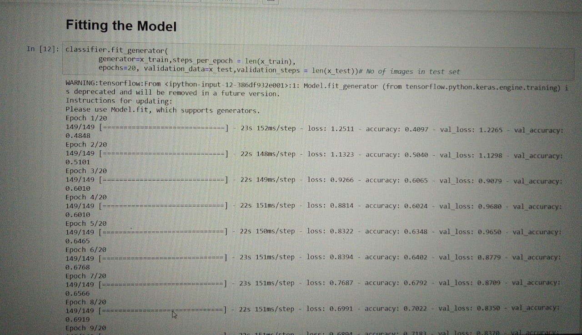
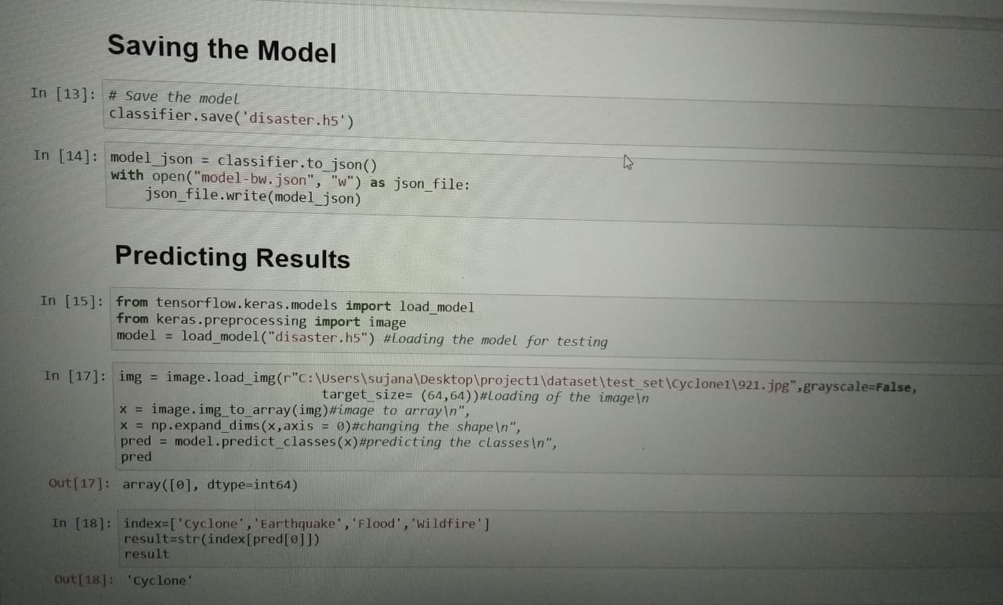
Experimental Investigations

Slide 7

Hardware and Software Specification's
Software Requirements:
Python ( 3.7 or older )
Anaconda Prompt
Jupyter Notebook
OpenCV
CNN
Keras
TensorFlow
Flask
Hardware Requirements :
Processor: Minimum 1 GHz; Recommended 2GHz or more.
Ethernet connection (LAN) OR a wireless adapter (Wi-Fi)
Hard Drive: Minimum 32 GB; Recommended 64 GB or more.
Memory (RAM): Minimum 1 GB; Recommended 4 GB or above.

Slide 8
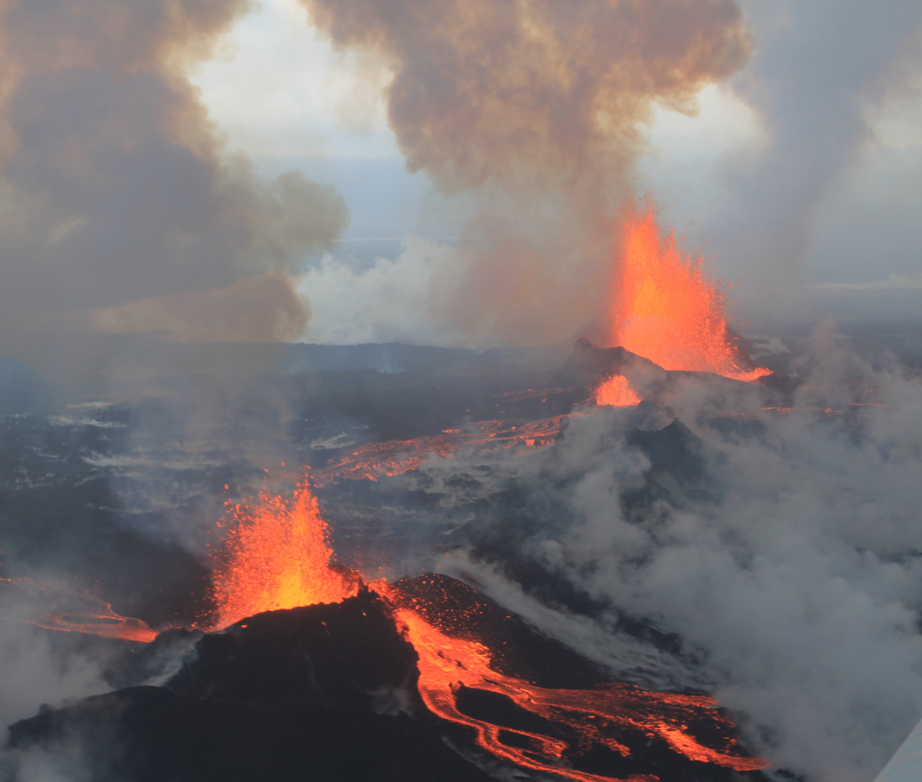
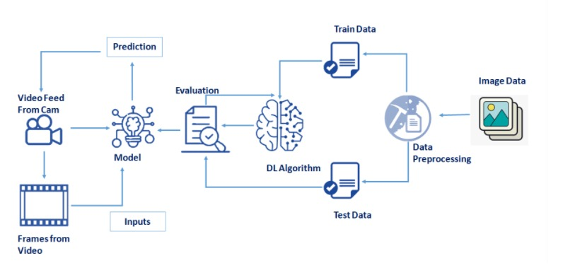
FlowChart
This Photo by Unknown author is licensed under CC BY-SA.

Slide 9
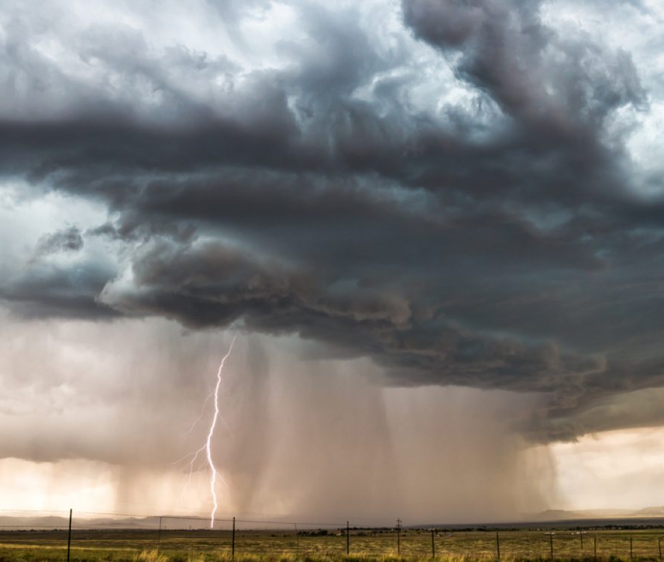
Conclusion
The natural disaster in Indonesia frequently happened, due to the geographical position of the country. Thus, natural disasters mostly occurred as an impact of the natural condition. However, the weather and climate condition has also influenced and triggered the disasters.
This Photo by Unknown author is licensed under CC BY-NC-ND.

Slide 10

Future Scope
In the future, the research will be continued
to obtain the data from all over the country, not
only west java province, and with the use of
more complete analysis, so that the government
or related institution could make a better
anticipation work as a mitigation effort.

Slide 11

Bibliography
CHENG Li-hai1,TANG Hong3,4,ZHOU Ting-gang1,2,ZHANG Lu3,5,ZHANG Min1. Evaluation method of natural disaster intensity and its application.
Muhammad Aamir 1 , Tariq Ali 1, Muhammad Irfan 2 , Ahmad Shaf 1 , Muhammad Zeeshan Azam 3 , Adam Glowacz 4 , Frantisek Brumercik 5 , Witold Glowacz 4 , Samar Alqhtani 6 and Saifur Rahman 2: Natural Disasters Intensity Analysis and Classification Based on Multispectral Images Using Multi-Layered Deep Convolutional Neural Network
https://pdfs.semanticscholar.org/c1bb/6a735f421b950d25eaf85e1044801d26e97d.pdf%E2%80%8B
Andi Wahju Rahardjo Emanue, Rania Rizki Arinta: Natural Disaster Application on Big Data and Machine Learning: A Review,
https://www.researchgate.net/publication/337444578_Natural_Disaster_Application_on_Big_Data_and_Machine_Learning_A_Review
P. K. Freeman, M. Keen, and M. Mani, “Being prepared,” Finance Dev., vol. 40, no. 3, pp. 42–5, 2003.
This Photo by Unknown author is licensed under CC BY-SA.

